Slide 1
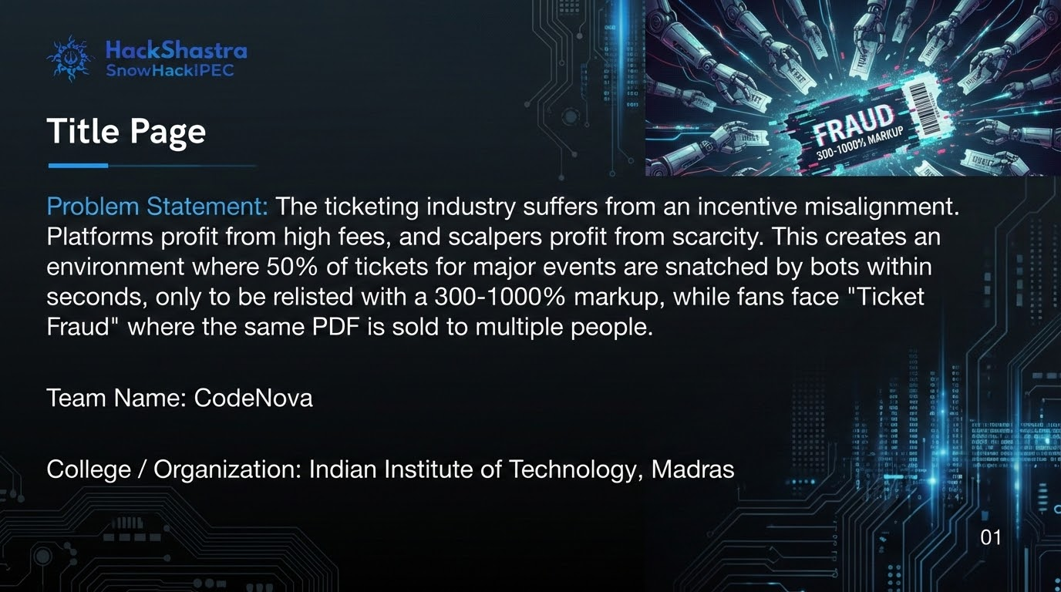

Slide 2
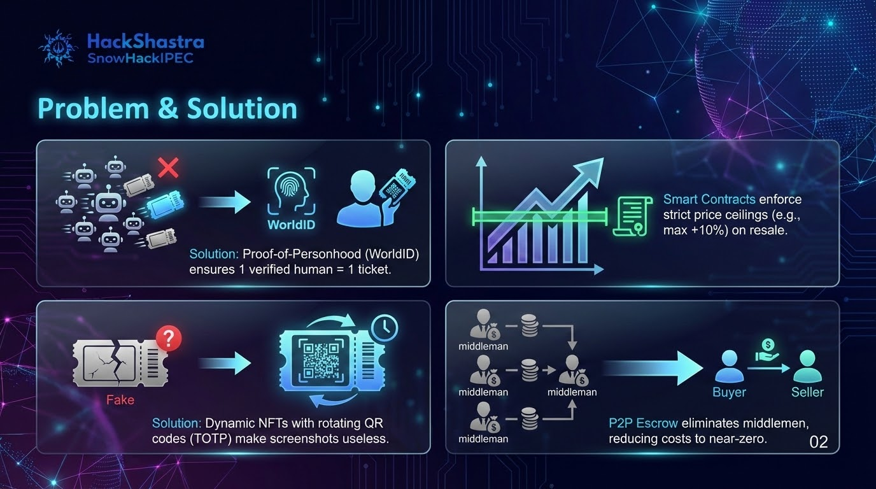

Slide 3
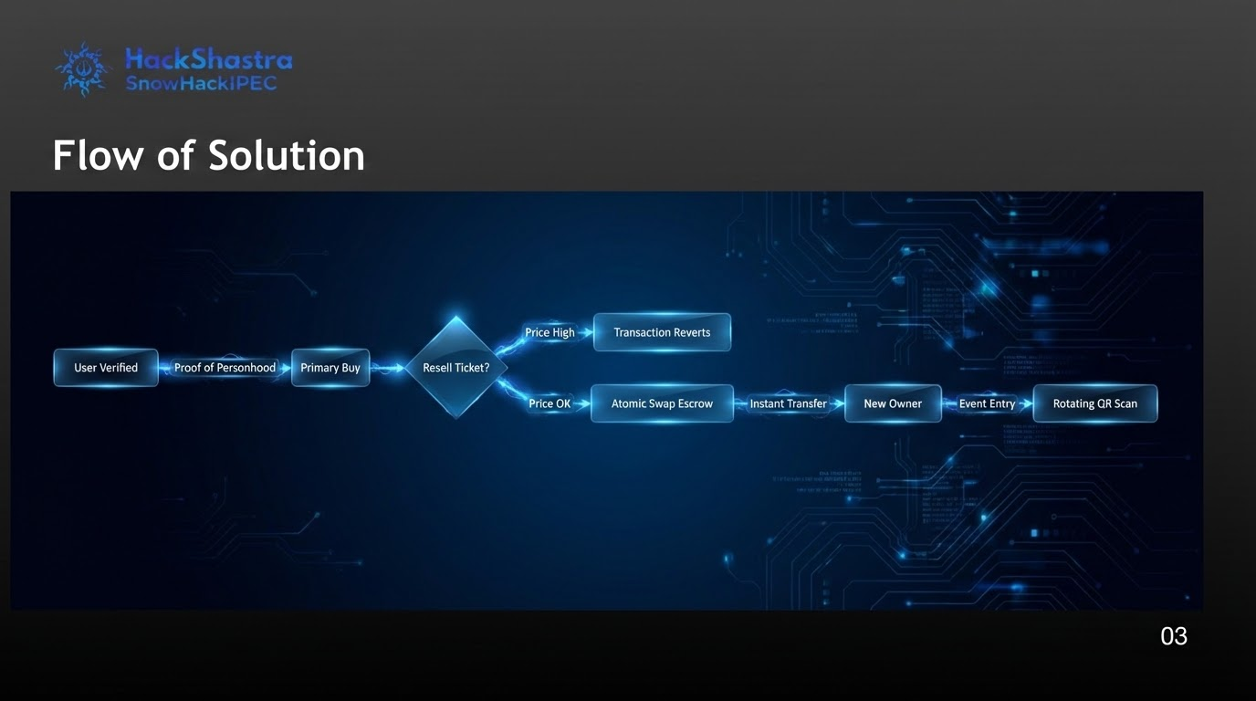

Slide 4

Tech Stack & Approach
Tech Stack:
Frontend - Next js, Privy
On-Chain - Solidity
Blockchain - Polygon
Backend - Node js, PostgreSQL
Execution Layer
Solidity (ERC-721): Tickets as programmable assets with on-chain enforcement of ownership, resale constraints, royalties, and consumption state.
Settlement & Scalability
Polygon: High-throughput, low-latency settlement enabling real-time resale and verification with negligible gas overhead.
Identity & Sybil Resistance
World ID (ZKP): Proof-of-personhood without identity disclosure to prevent bot-driven scalping and multi-wallet abuse
04

Slide 5
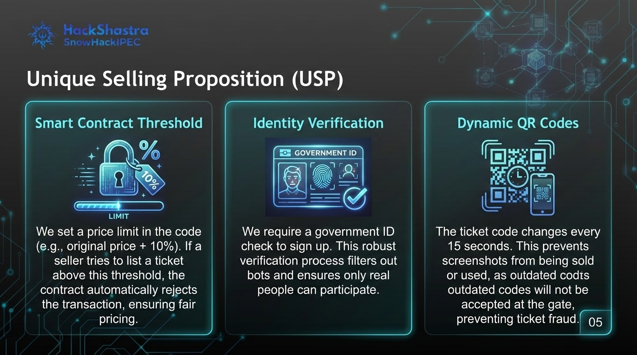

Slide 6
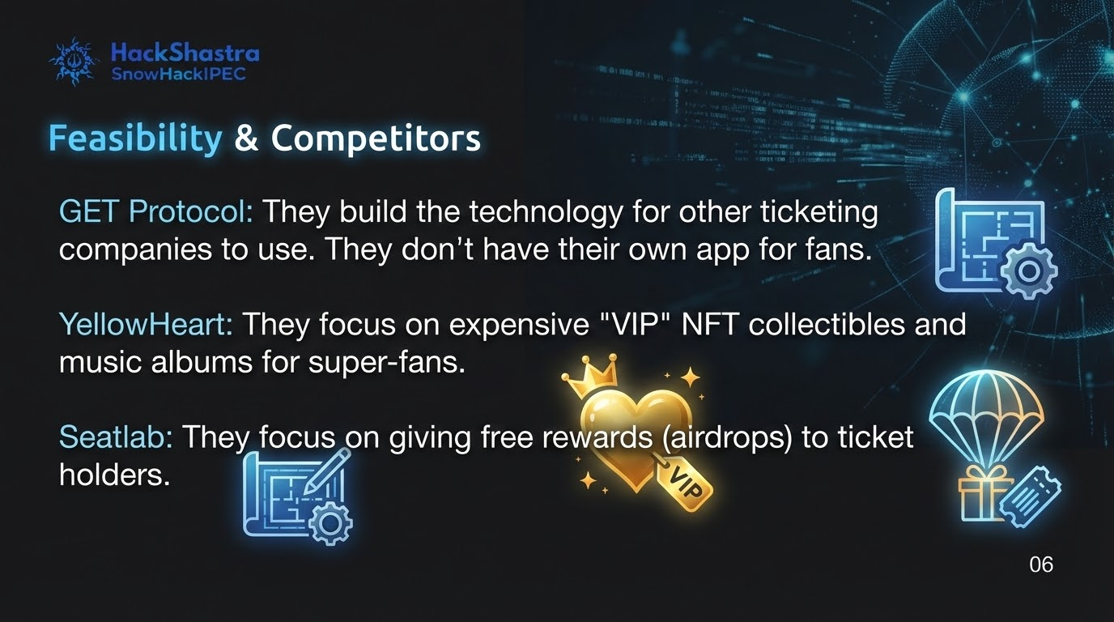

Slide 7
